Slide 1


Optical Character Recognition(OCR) for
Data Collection
Presented By
Arnab Sen Sharma
Reg : 2013331017
Maruf Ahmed Mridul
Reg : 2013331015
Department of
Computer Science & Engineering

Slide 2
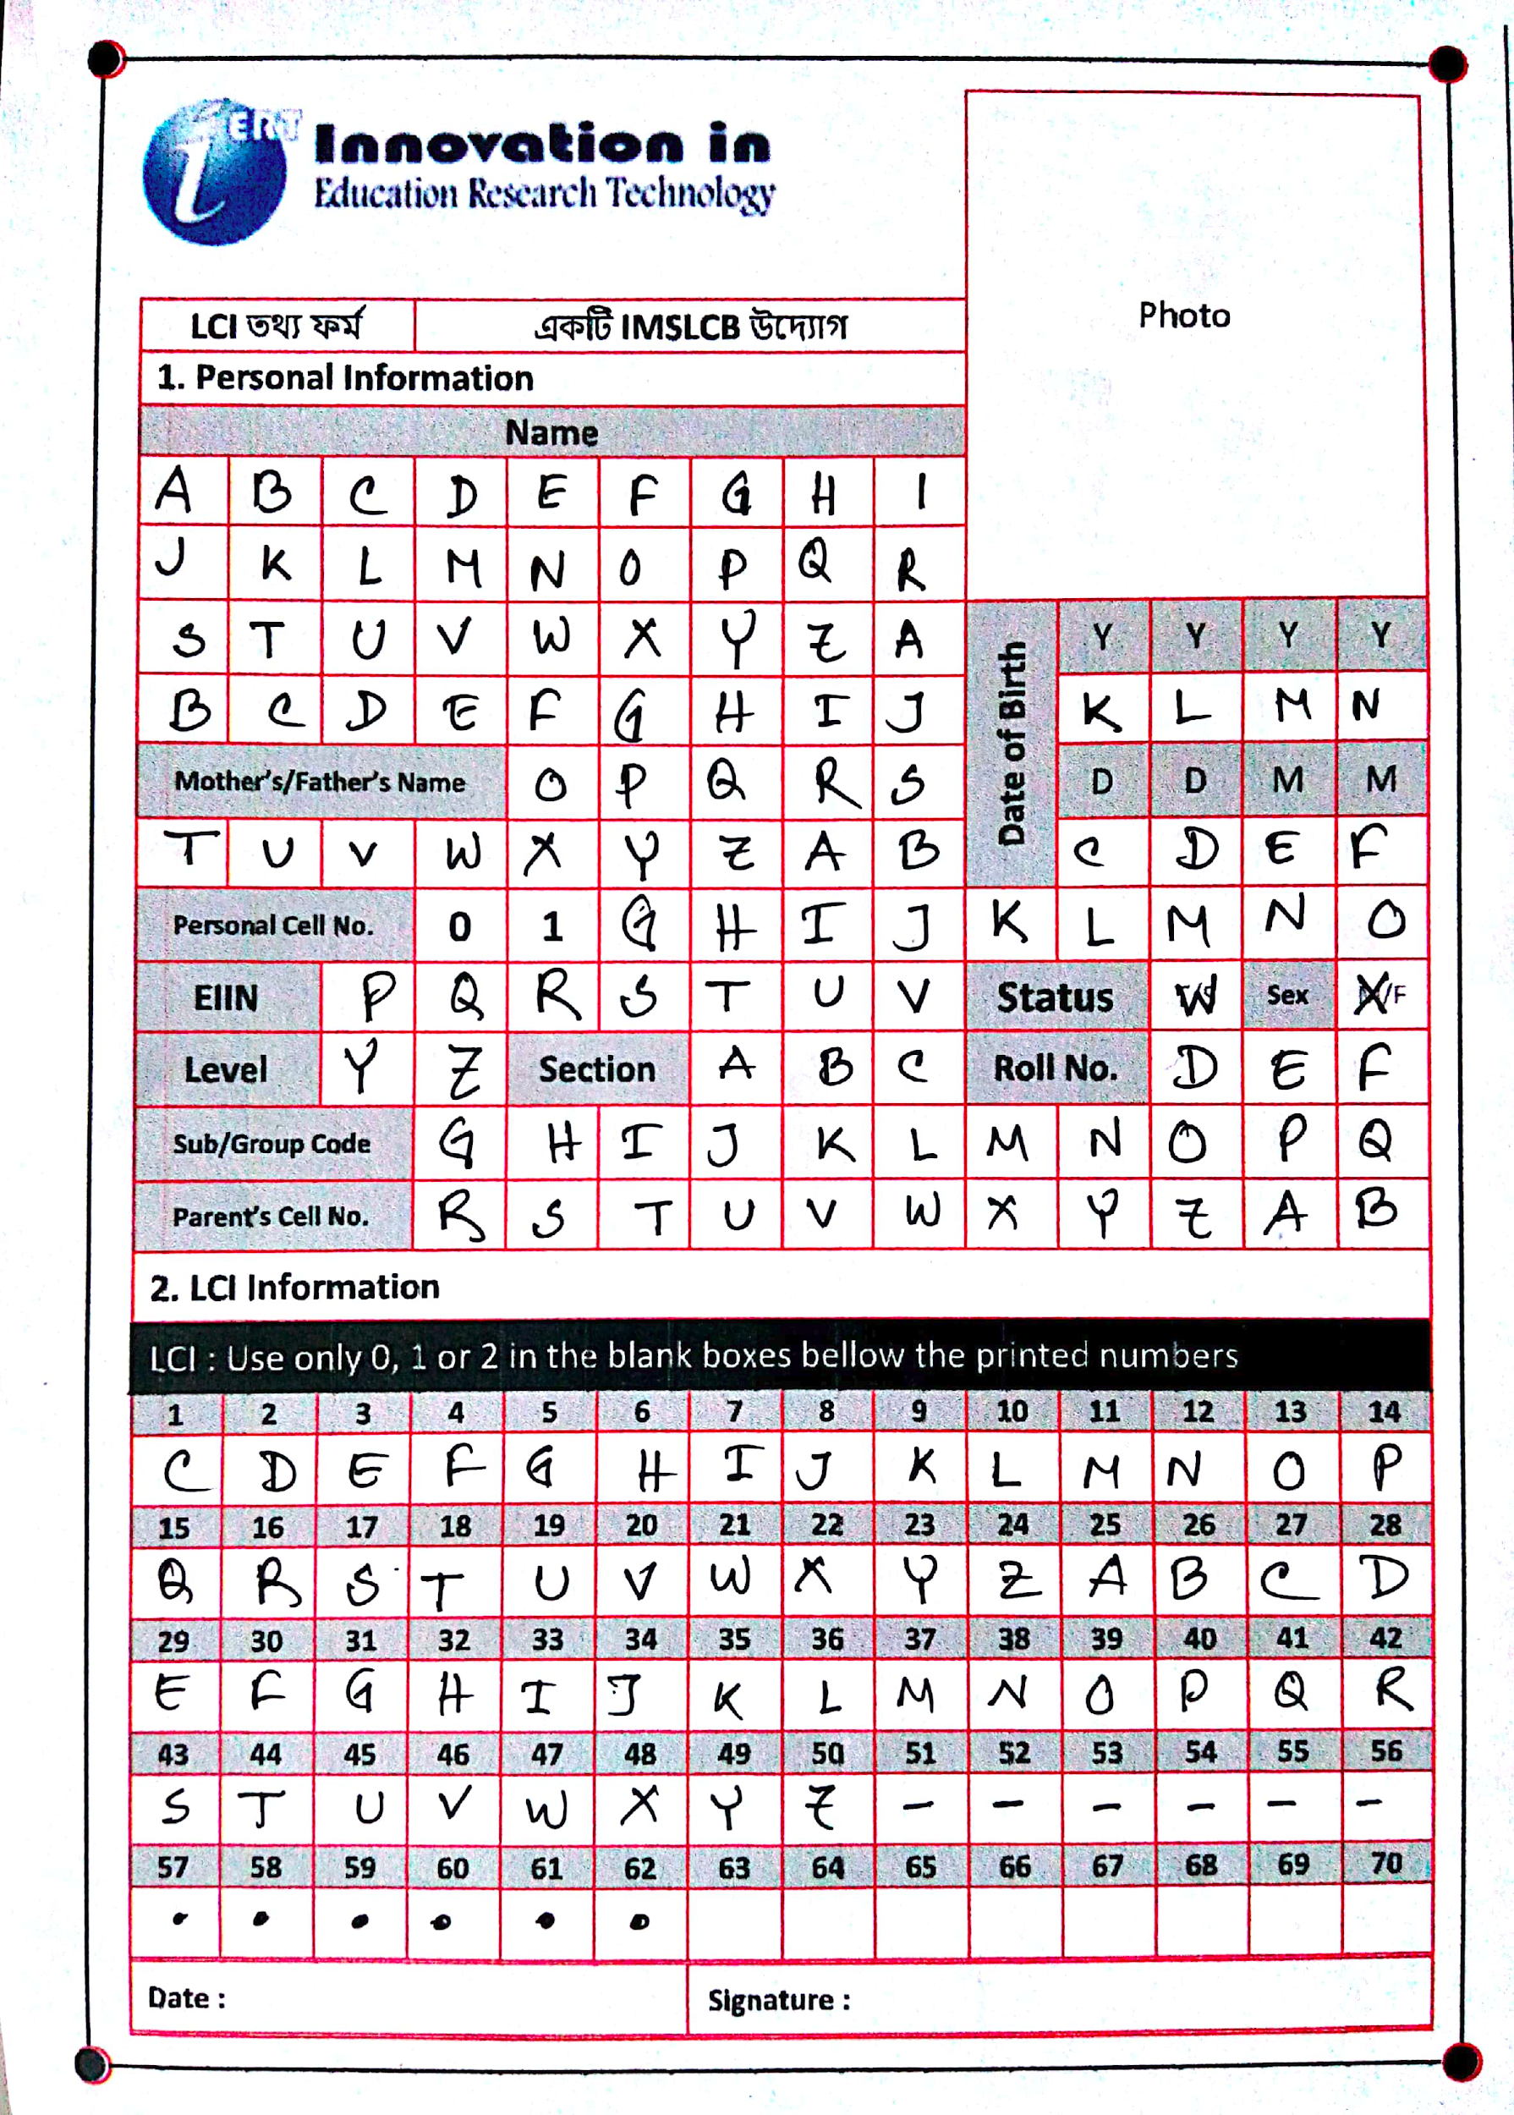
AIM
Text File
1

Slide 3
WHY ?
Main purpose is to collect data and prepare a character dataset.
176 characters (Capital alphabets and digits)
3 images
A photo
A signature
A date
From a single form !
2

Slide 4
METHODOLOGY
Cropping and Aligning
Input (Form)
Cell Extraction
Feeding the trained model
Feature Extraction
Preprocessing
Predictions
Text File
3

Slide 5
FORM SPECIFICATION
Should be Color Printed
Should be scanned by
CamScanner without flash
No background is allowed
Image should be Portrait
4

Slide 6
CROPPING AND ALIGNING
Detecting the Markers
Blob Detector Fails !
Different Image Scenarios
Minimum average pixel
value works !!
Convex Hull
Dynamic Programming
5

Slide 7
CROPPING AND ALIGNING
Perspective Transformation
after cropping
6

Slide 8
CELL EXTRACTION
Extracting each cell by splitting each row into 14 (columns) parts
Removing unnecessary cells
Top Left and Bottom Right Corners finding for 16 rows
Cropping the rows
7

Slide 9
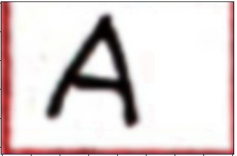
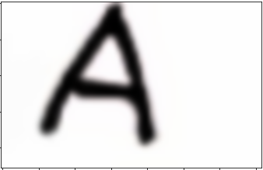
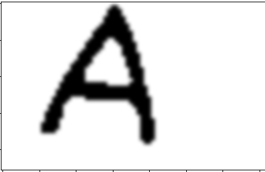


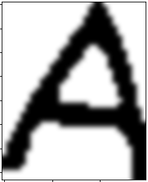

PREPROCESSING
Initial
Denoised & Border Removed
Thresholded
Resized (28 X 28)
Inverted
Middled
Cropped
8

Slide 10
FEATURE EXTRACTION
Pixel Values are the only feature
1 X (28X28) feature vector
Binarized pixel values (0 or 1)
9

Slide 11
SOME PREDICTIONS FROM THIS STAGE
Space :
< 20 white pixels
Dot :
> 20 and < 50 white pixels
10

Slide 12
TRAINING AND TESTING DATASET
Online data
EMNIST dataset for letters and digits
A_Z Handwritten alphabets from Kaggle
Real time data
From 120 persons using our form
Around 700 characters each
11

Slide 13
MODELS
Three models
A-Z English capital letters
0-9 English digits
0-2 English digits
12

Slide 14
MODEL STRUCTURE (ALPHABET)
2D convolutional layer with 32 filters, which takes 28*28 grayscaled image as input
Pooling layer of 5*5. Activation function ReLU.
Another 2D convolution layer.
Another pooling layer of 5*5.
Hidden layer of 512 neurons.
Dropout of 0.25
Output layer: Number of classes. Activation function Softmax.
Loss: Categorical Cross Entropy. Optimizer: Adam.
13

Slide 15
TRAINING THE MODEL
Alphabet: EMNIST + Kaggle. 20,000 samples for each class.
Digit: EMNIST. 28000 samples for each class.
Divided dataset using sklearn’s train_test_split function. 85% in training.
Accuracy:
Alphabet: 98.76%
Digit: 99.38%
14

Slide 16

TESTING THE MODEL
Tested the model on the dataset collected by us via the form.
Performance:
Alphabet: 78.36%
Digit: 82.58%
15

Slide 17
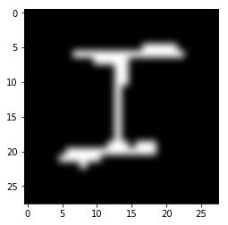
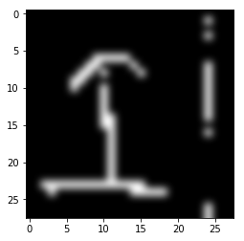
WH THE POOR PERFORMANCE?
Vs
16

Slide 18
APPROACH 1
Discard the online dataset. Train the model using only our dataset.
Insufficient data. Too much noise. Very poor performance on evaluation dataset.
17

Slide 19
APPROACH 2
Train with online dataset + our dataset.
A bit better performance.
Alphabet: 83.93%
Digit: 88.87%
Amount of our dataset is very low compared to amount of online dataset.
18

Slide 20
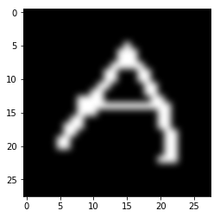
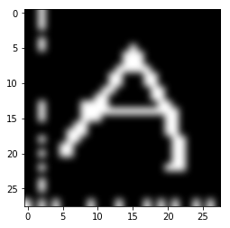
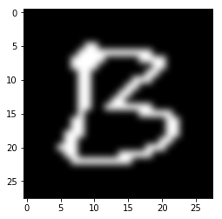
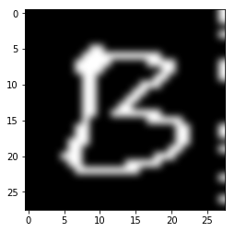
APPROACH 3
Modify the online dataset. Merge with our dataset.
19

Slide 21
APPROACH 3 (Cont.)
Performance improved significantly !!!
Alphabet: 94.39%
Digit: 96.58%
Digit(0-2): 98.77%
20

Slide 22
FAILING CASES
I and T
O and D
P and D
B and D
C and O
U and V etc.
May be interchanged sometimes for some
valid reasons
21

Slide 23
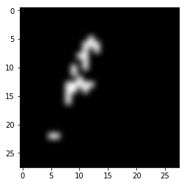
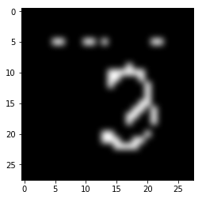
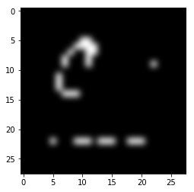
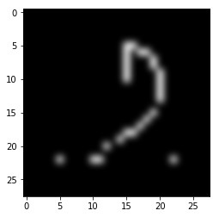
FAILING CASES (Cont.)
Everything depends on Good Scanning !!
22

Slide 24
FUTURE WORKS
Achieve the actual goal, that means real time run and collect the data.
23

Slide 25
Thank You

Slide 26
Questions and Suggestions ?

